Slide 1

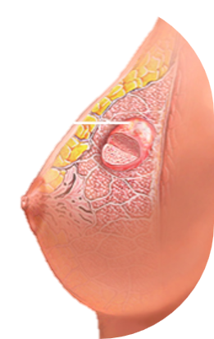
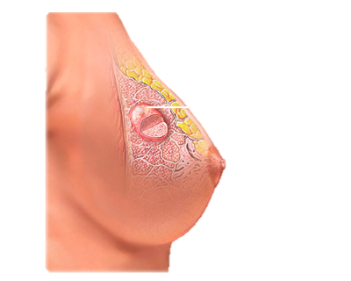
Breast Cancer
Prediction

Slide 2
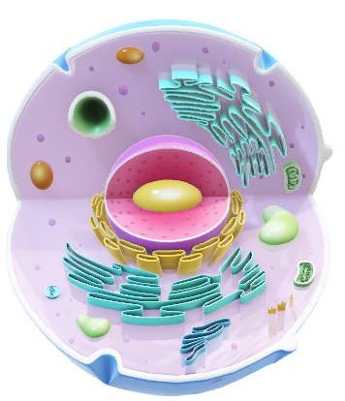
‘M’
Malignant
DATASET
DESCRIPTION
Benign
‘B’
Dataset Description
Real Valued Features of Nucleus
ID Number
Diagnosis
Radius
Texture
Perimeter
Area
Smoothness
Compactness
Concave points
Symmetry
Fractal dimension
Fractal geometry

Slide 3
Checked for missing values
Dropped unnamed: 32 Column
Converted diagnosis to binary
Removed standard error and worst value category
33
Number of Columns
3
Column Categories
10
No. features each
Mean
Std. Error
Worst Values
Data examination
Data cleaning

Slide 4
Checked for missing values
Dropped unnamed: 32 Column
Converted diagnosis to binary
Removed standard error and worst value category
Checked for duplicate rows
33
Number of Columns
3
Column Categories
10
No. features each
Mean
Std. Error
Worst Values
Data examination
Data cleaning

Slide 5
Checked for missing values
Dropped unnamed: 32 Column
Converted diagnosis to binary
Removed standard error and worst value category
Checked for duplicate rows
33
Number of Columns
3
Column Categories
10
No. features each
Mean
Std. Error
Worst Values
Data examination
Feature understanding

Slide 6

Correlation Between
Diagnosis and Variables
100th
75th
PERCENTILE
25th
0th
Radius
Texture
Perimeter
Area
Smooth
Compact
Concavity
Con Points
Symmetry
Frac dim

